Slide 1
Analyzing the Impact of Car Features on Price and Profitability
VICTOR SHAH
Dataset link : https://docs.google.com/spreadsheets/d/1-UzV0aXl0rl3WalFDZteQvRa6xe1atgG/edit?usp=drive_link&ouid=111667124296828215097&rtpof=true&sd=true
Video link: https://drive.google.com/file/d/1G-aZ9bvKMX0BE7jhyfjr_1e2hStIKGSm/view?usp=drive_link
Tableau link: https://public.tableau.com/app/profile/victor.shah/viz/AnalyzingtheImpactofCarFeaturesonPriceandProfitability_17050770668790/Dashboard1#2

Slide 2
Project Description
As a data analyst my primary responsibility is how can a car manufacturer optimize pricing and product development decisions to maximize profitability while meeting consumer demand.
In recent years, there has been a growing trend towards electric and hybrid vehicles and increased interest in alternative fuel sources such as hydrogen and natural gas. At the same time, traditional gasoline-powered cars remain dominant in the market, with varying fuel types and grades available to consumers.
The automotive industry has been rapidly evolving over the past few decades, with a growing focus on fuel efficiency, environmental sustainability, and technological innovation.

Slide 3
Approach
Downloading the dataset: The first step is downloading the excel file (.csv) into the local device. Make sure the downloaded file is having the extension (.xlsx).
Understanding the worksheet: The next step is to examine the structure of the table holding the data in the Excel Sheet. (Project 7 Dataset)
Identifying the key tables: Identification of the primary key from the dataset of excel files.
Data Cleaning: This is the preprocessing step that makes the data suitable for analysis. It includes handling missing values, removing duplicates.
Data Visualization: To use EDA to understand how car features affects the market prices for each brand.
Using Tableau: To further enhance the visualization, the dashboard is made to represent the findings to the stakeholders or other employees.

Slide 4
DATA ANALYTICS TASKS

Slide 5
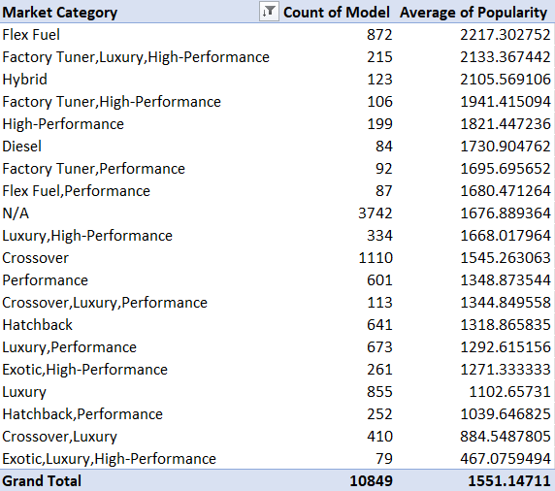
Insight Required: How does the popularity of a car model vary across different market categories?
Task 1.A: Create a pivot table that shows the number of car models in each market category and their corresponding popularity scores.
The table beside shows the top 20 Market Category’s corresponding to their popularity scores.

Slide 6
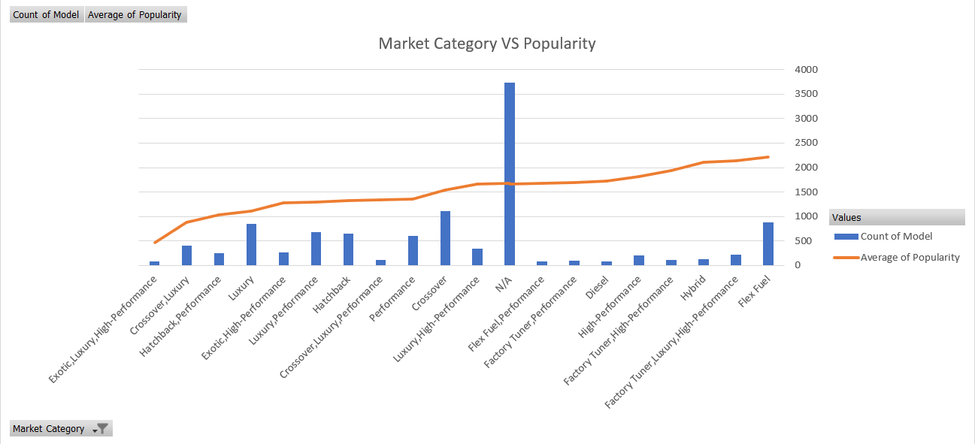
Task 1.B: Create a combo chart that visualizes the relationship between market category and popularity.
The chart below is a combo chart that shows the top 20 market categories based on their popularity scores.

Slide 7
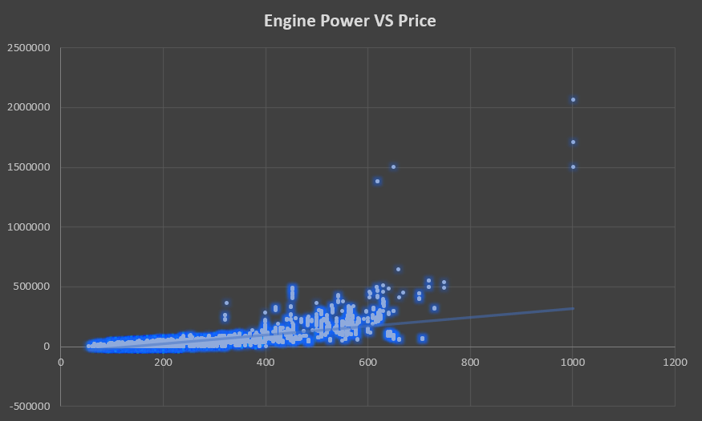
Insight Required: What is the relationship between a car's engine power and its price?
Task 2: Create a scatter chart that plots engine power on the x-axis and price on the y-axis. Add a trendline to the chart to visualize the relationship between these variables.
The chart below is a scatter chart having a rising trendline. This means the price increases with the engine power.

Slide 8
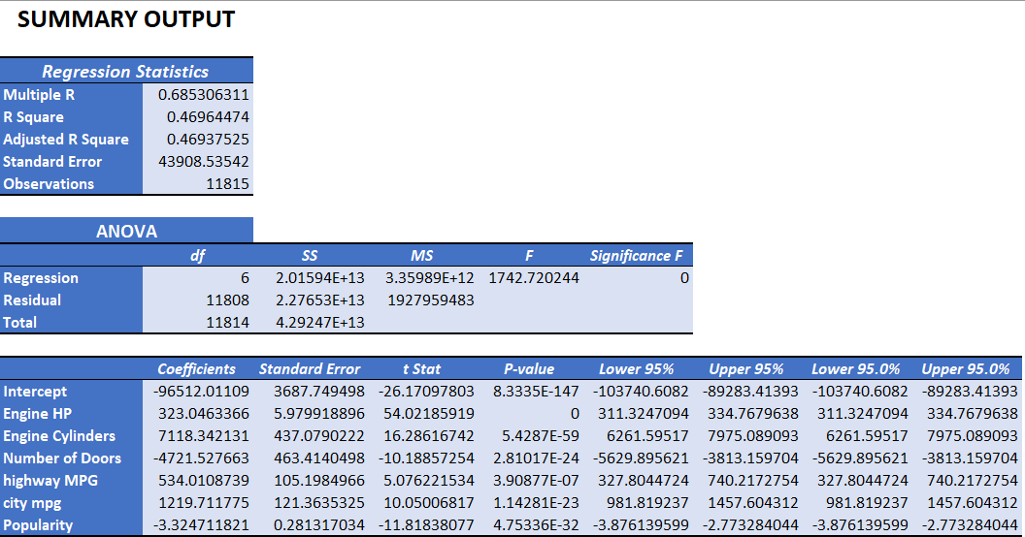
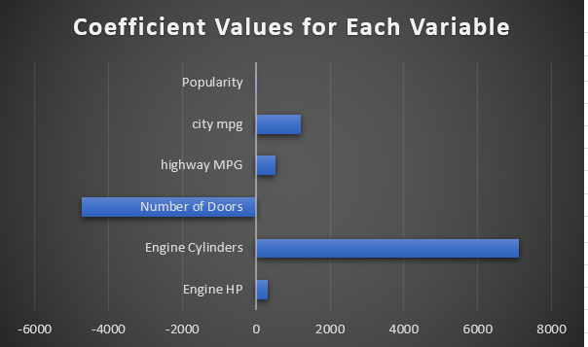
Insight Required: Which car features are most important in determining a car's price?
Task 3: Use regression analysis to identify the variables that have the strongest relationship with a car's price. Then create a bar chart that shows the coefficient values for each variable to visualize their relative importance.
The table below is the regression analysis to identify the relationship with the car’s price.
The Bar Chart besides shows the coefficient values for each variable

Slide 9
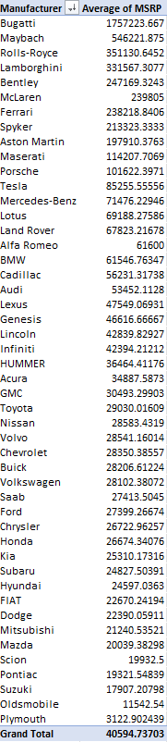
Insight Required: How does the average price of a car vary across different manufacturers?
Task 4.A: Create a pivot table that shows the average price of cars for each manufacturer.
The table beside shows the average price for each car brand/manufacturer.

Slide 10
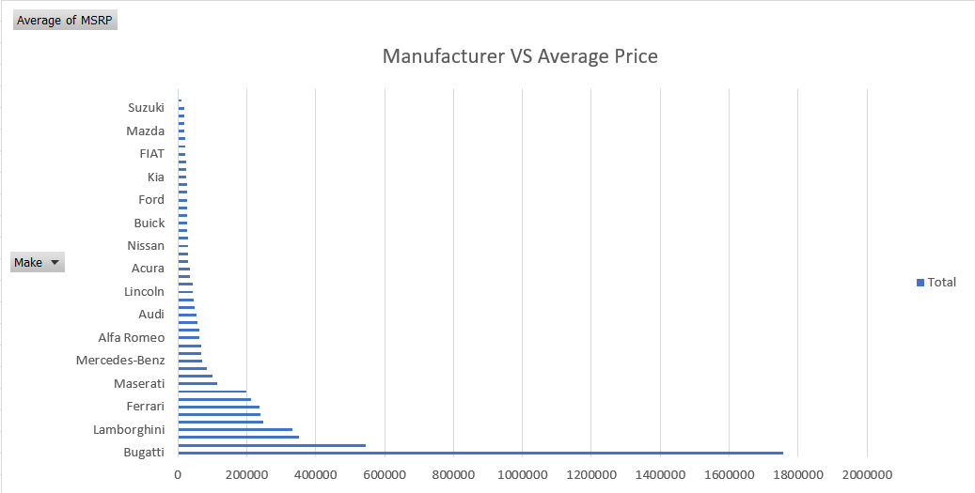
Task 4.B: Create a bar chart or a horizontal stacked bar chart that visualizes the relationship between manufacturer and average price.
The chart below is a horizontal bar chart that visualizes the relationship between the manufacturer/brand and the average price.

Slide 11
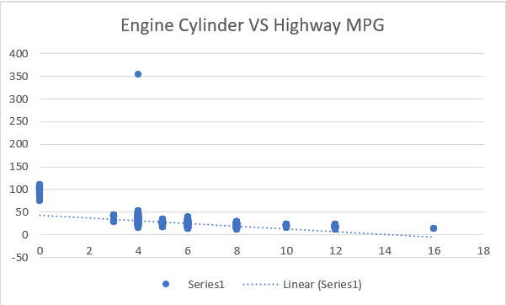
Insight Required: What is the relationship between fuel efficiency and the number of cylinders in a car's engine?
Task 5.A: Create a scatter plot with the number of cylinders on the x-axis and highway MPG on the y-axis. Then create a trendline on the scatter plot to visually estimate the slope of the relationship and assess its significance.
The chart beside shows the scatter plot with the number of cylinders on the x-axis and highway MPG on the y-axis.
The negative trendline shows that the increase in the engine cylinder leads towards the decrease in the Hight MPG

Slide 12
Task 5.B: Calculate the correlation coefficient between the number of cylinders and highway MPG to quantify the strength and direction of the relationship.

Slide 13
BUILDING THE DASHBOARD

Slide 14
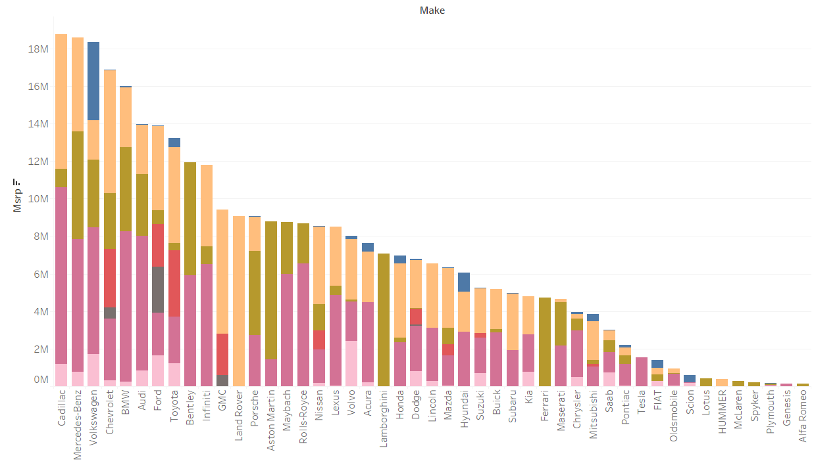
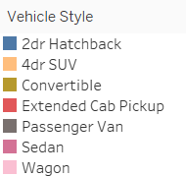
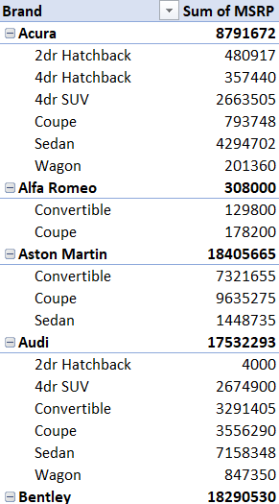
Task 1: How does the distribution of car prices vary by brand and body style?

Slide 15
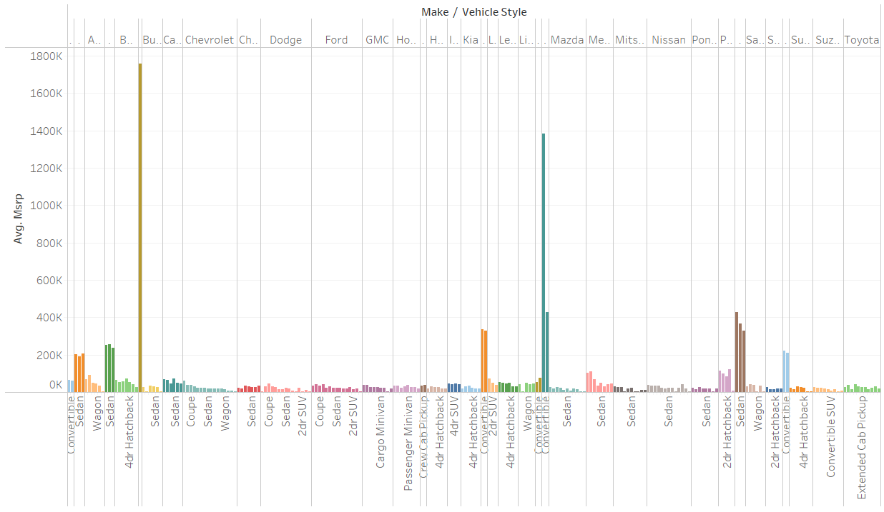
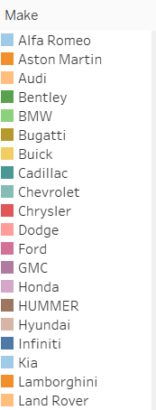
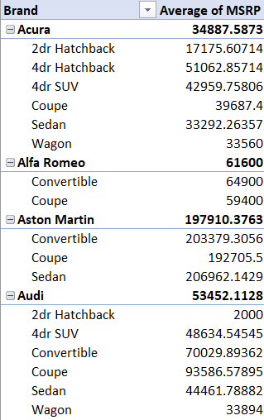
Task 2: Which car brands have the highest and lowest average MSRPs, and how does this vary by body style?

Slide 16
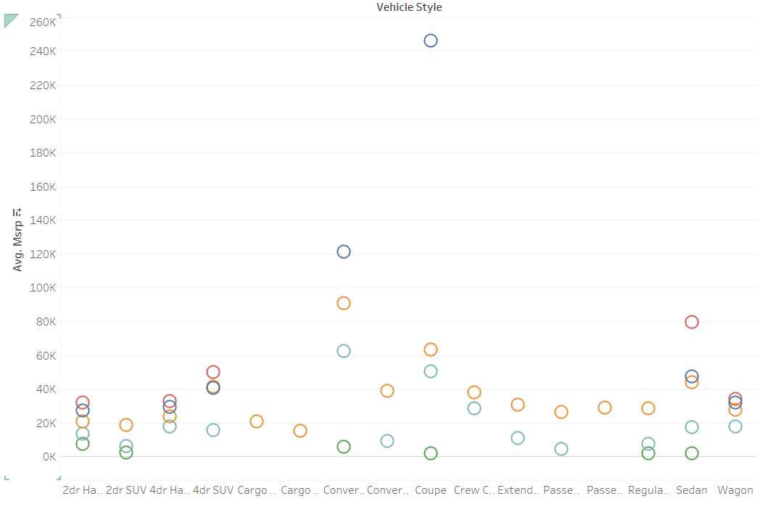
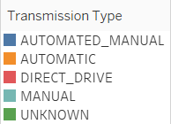
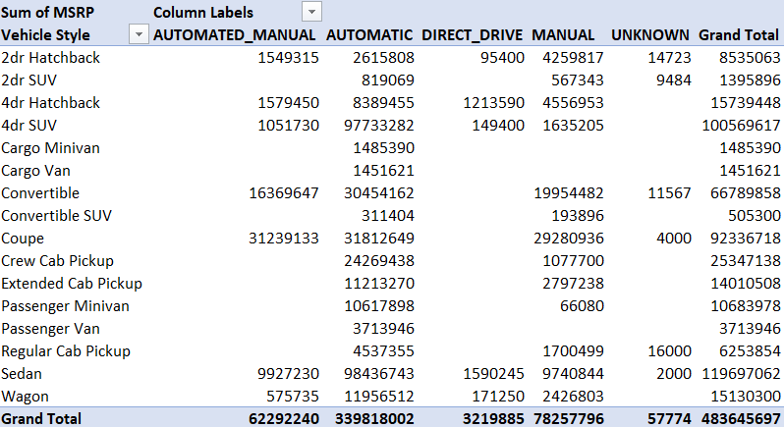
Task 3: How do the different feature such as transmission type affect the MSRP, and how does this vary by body style?

Slide 17
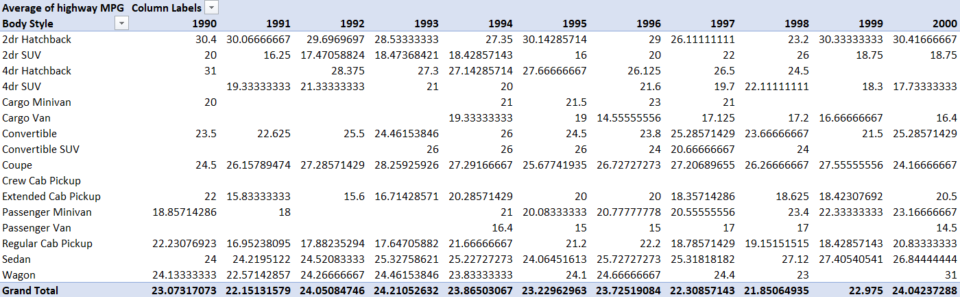
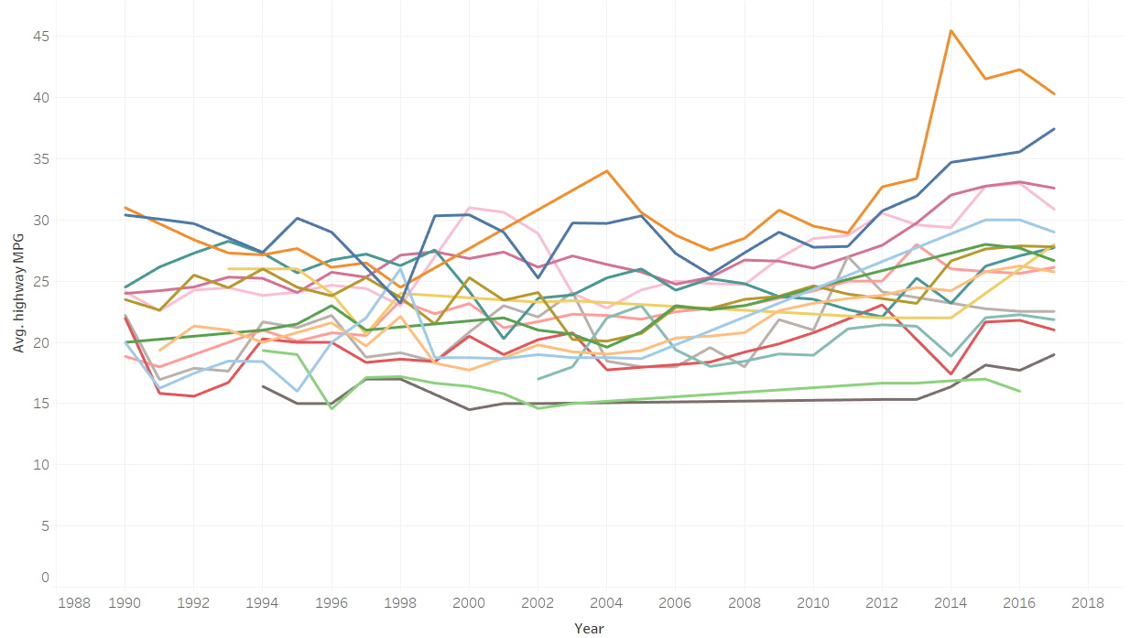
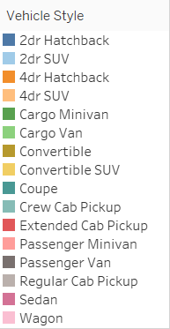
Task 4: How does the fuel efficiency of cars vary across different body styles and model years?

Slide 18
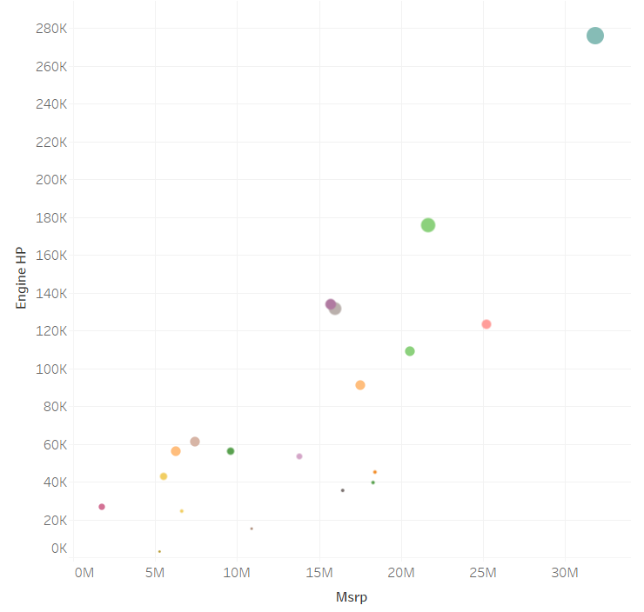
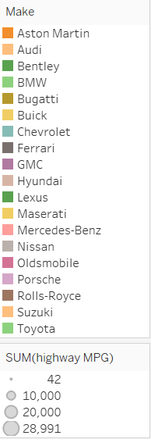
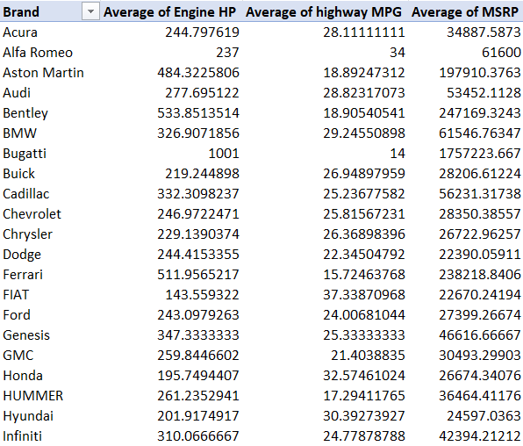
Task 5: How does the car's horsepower, MPG, and price vary across different Brands?

Slide 19
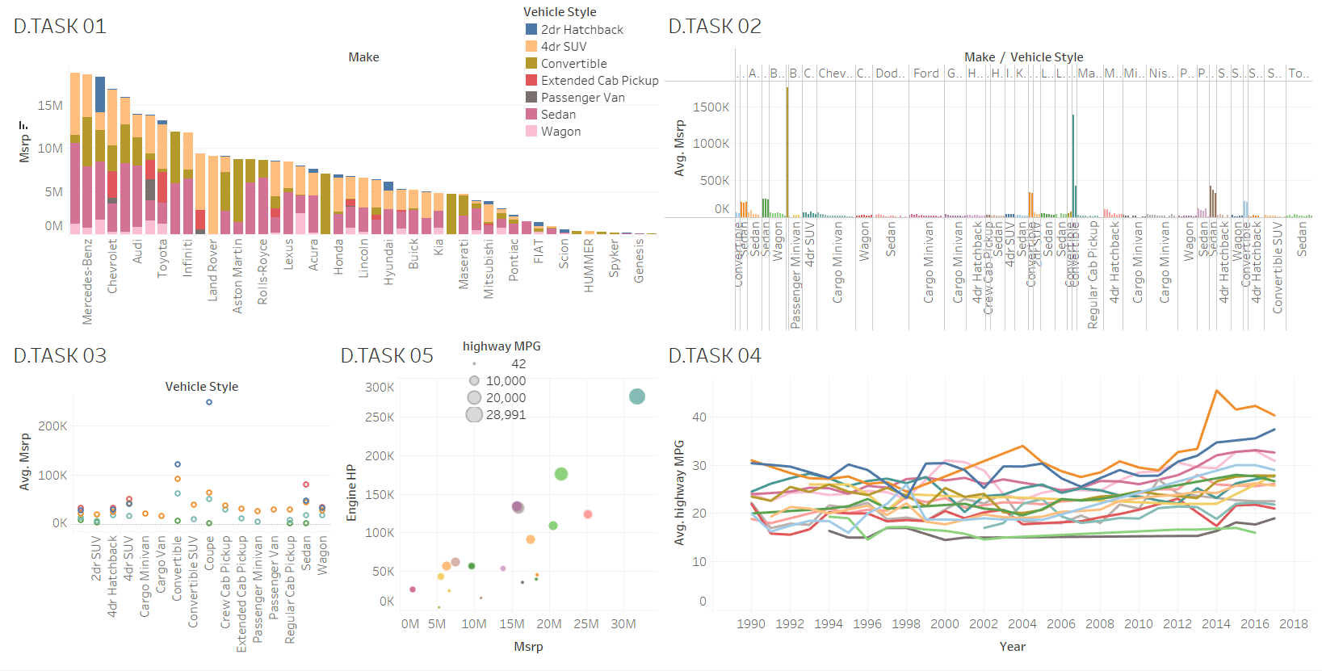
Tableau Dashboard

Slide 20
Tech-Stack Used
Microsoft Excel: It is a spreadsheet program from Microsoft and a component of its Office product for business application. This enables users to format, calculate and organize data in a spreadsheet.
MS Excel Functions: They are predefined formulas that perform calculations by using specific values, called arguments, in a particular order or structure. Some of the functions are:
1. Text function: clean(), substitute(), replace(), concatenate(), trim(), etc.
2. Mathematical and Statistical functions: sum(), sumif(), count(), max(), average(), median(), mode(), stdev(), correl(), etc.
Data Visualization in Excel: Bar, Column, Scatter, Stacked Chart, horizontal chart bubble chart.
Tableau: It is a software company that offers collaborative data visualization software for organizations working with business information analytics.

Slide 21
Insights
We were able to find out the popularity of a car model varying across different market categories.
To find out the relationship between the car’s engine power and its price.
Which car features are most important in determining a car’s price?
How the average price of a car vary across different manufacturers?
What is the relationship between fuel efficiency and the number of cylinders in a car’s engine?
Which car brands have the highest and lowest average MSRP, and how does this vary by body style?
How does the distribution of car prices vary by brand and body style?

Slide 22
Results
Remembering to adapt excel functions on specific dataset.
These learned insights helped me understand specific business questions which were addressed by MS Excel.
Learning about Excel Text and Statistical functions. The importance of average(), median(), mode(), text(), functions.
We were able to build different charts for visualization for answering the business questions. Some of the charts used were bar graph, stacked Chart and heatmap.
Achieving the ability to learn and write MS Excel functions to execute different business questions.
Solving Company related problems using different visualization charts offered by Tableau

Slide 23
Thank you

